Slide 1
Recommending where to construct gyms in Manhattan, New York
May 26th 2019

Slide 2
Introduction / Business Problem
Goal - To find the best suited location for opening gyms.
This report is targeted and will be a help for stakeholders who want to open a gym in Manhattan, New York.

Slide 3
Introduction / Business Problem(Cont.)
Problem:
High population of Manhattan
Therefore increased demand for gyms
Some areas are completely devoid of gyms
People need to travel far just for such a basic facility.
This report identifies areas which have no facility of gym nearby

Slide 4
Data and Data Pre-processing
This dataset is from New York University Libraries of New York from Spatial Data Repository of NYU.
This file is downloaded and cleaned.
The dataset contains 5 main boroughs and the neighborhoods

Slide 5
Data and Data Pre-processing(Cont.)
Based on definition of our problem, factors that will influence our decision are:
1. Number of existing gyms in the neighbourhood
2. Number of neighbourhood devoid of gyms

Slide 6
Methodology
Foursquare API is used to explore the neighbourhoods in Manhattan and segment them.
We have 2 goals –
To find neighbourhoods with very few gyms.
To find neighbourhoods with no gyms

Slide 7
Methodology(Cont.)
2 major dataframes
venues_with_gym
Used to find number of gyms in neighbourhood and cluster neighbourhoods which have high frequency of gyms
df_no_gyms
Used to find neighbourhoods with no gym

Slide 8
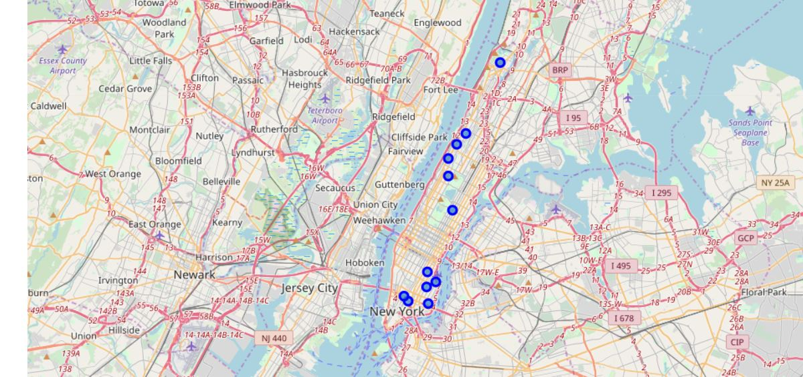
Methodology(Cont.)
Neighbourhoods which have no gyms visualized via folium.

Slide 9
Results
After all the processing, we observe the following results-
There are very few neighbourhoods which have sufficient amount of gyms
The best options for creating gyms are neighbourhoods with no gym. These are –
Inwood
Hamilton Heights
Manhattanville
Upper East Side
East Village
Lower East Side
Little Italy
Soho
Manhattan Valley
Morningside Heights
Gramercy
Stuyvesant Town

Slide 10
Thank you!

